Slide 1
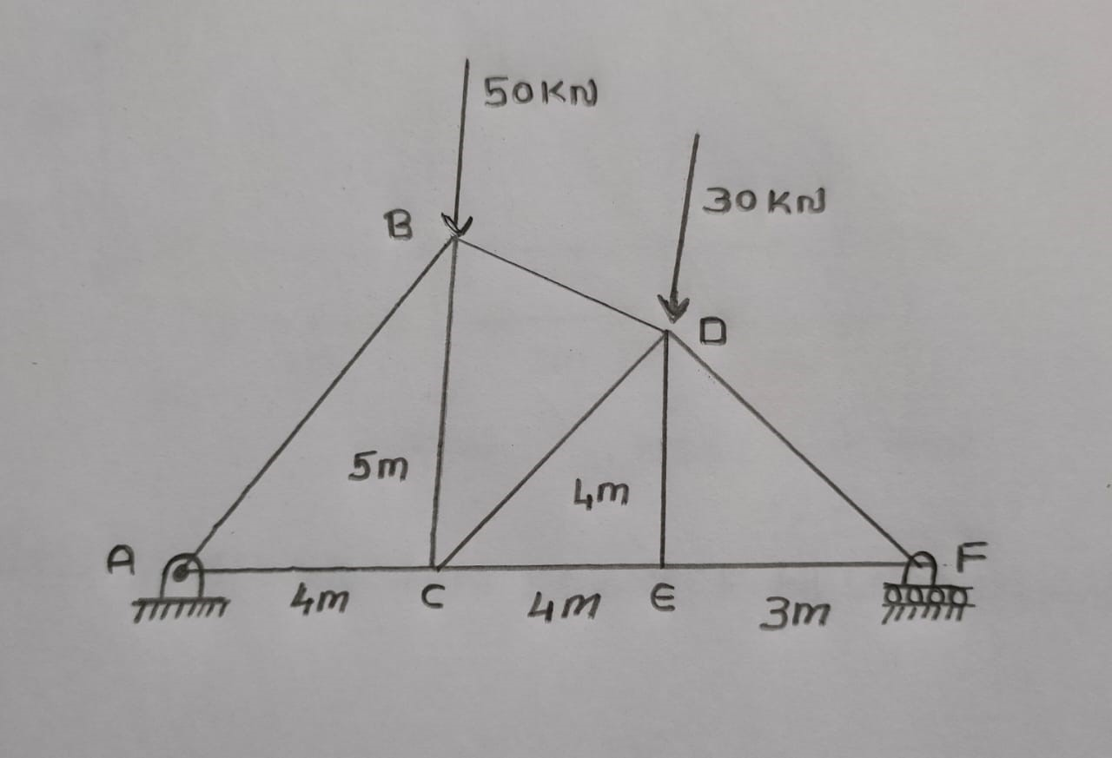
QUESTION 1
(A) Compute the force in all members of the truss .
(B) Using Matlab, find the variation of forces in all members when the force F(magnitude 50kN) acting at B acts at different angles (0 – 360 degrees).

Slide 2
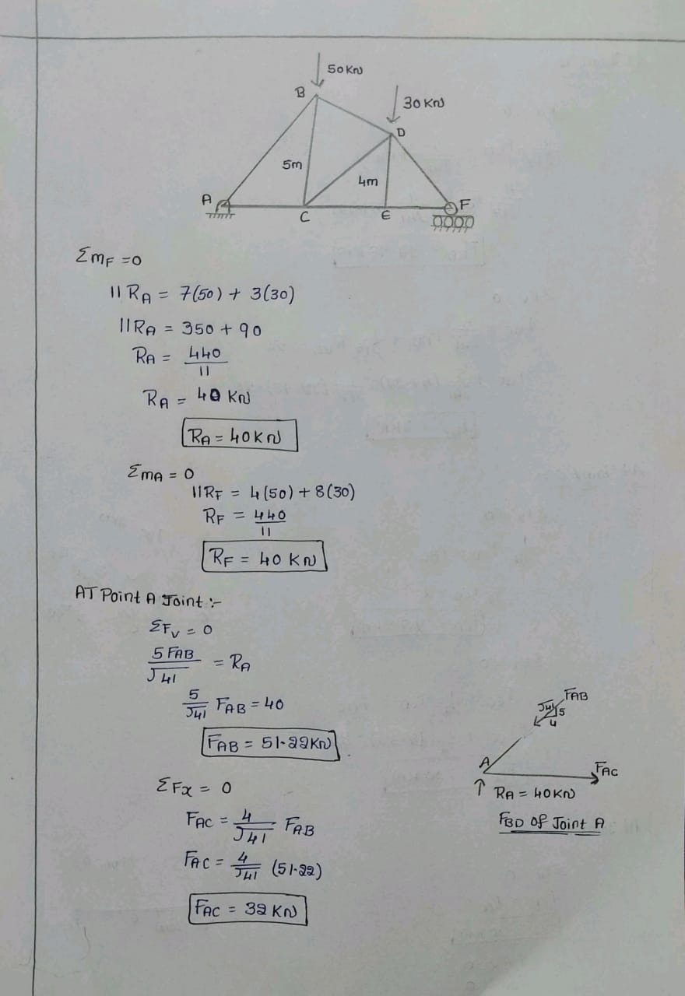
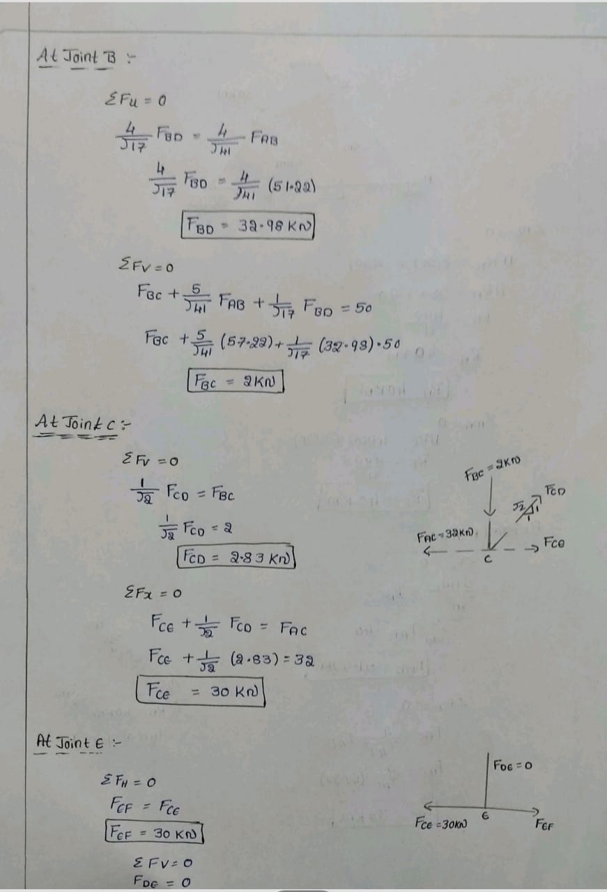

Slide 3
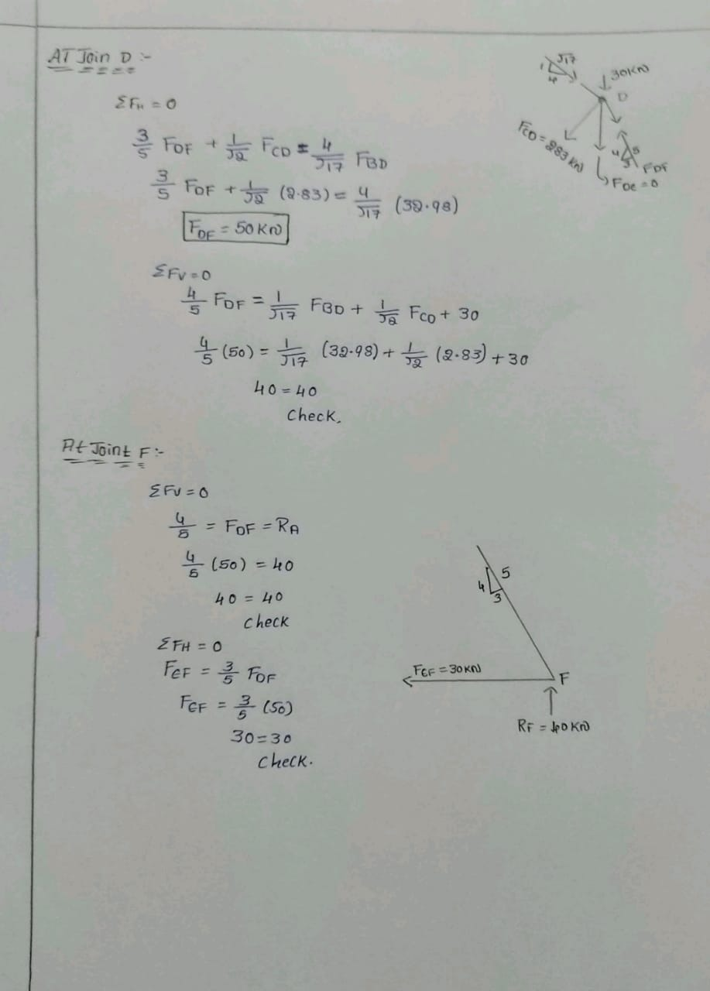

Slide 4
Member Forces | Magnitude | Nature of Force
FAB | 51.22 kN | Compression
FAC | 32 kN | Tension
FBC | 2 kN | Compression
FBD | 32.98 kN | Compression
FCE | 30 kN | Tension
FDC | 2.83 kN | Tension
FDF | 50 kN | Compression
FEF | 30 kN | Tension

Slide 5
Concepts
METHOD OF JOINTS
EQUILIBRIUM CONDITIONS
SUPPORT REACTIONS

Slide 6
theta = 0:1:360;
F = 50;
x = F*cosd(theta);
y = F*sind(theta);
RAH = -x;
RAV = (-5*x-7*y+90)/11;
RF = (5*x-4*y+240)/11;
AB = -(RAV*sqrt(41)/5);
AC = -RAH-(4*AB/sqrt(41));
BD = ((4*AB/sqrt(41))-x)*sqrt(17)/4;
BC = y-BD*sqrt(17)-(5*AB)/sqrt(41);
CD = -sqrt(2)*BC;
CE = AC-(CD/sqrt(2));
DE = 0;
EF =CE;
DF = (CD/sqrt(2) + BD*4/sqrt(17))*5/3;
plot(theta,AB,'r',theta,AC,'b',theta,BD,'c',theta,BC,'y',theta,CD,'k', theta,CE,'m',theta,DF,'g',theta, DE ,'r')
legend('AB','AC','BD','BC','CD','CE,EF','DF','DE')
axis([0,500,-500,500])
xlabel('\theta');
ylabel('Forces');
title('Variation of Forces v/s Angle');
MATLAB CODE

Slide 7
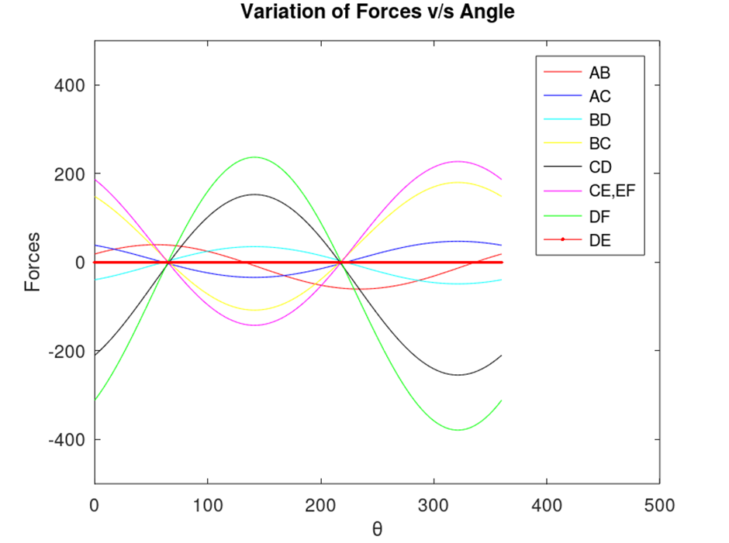

OUTPUT

Slide 8
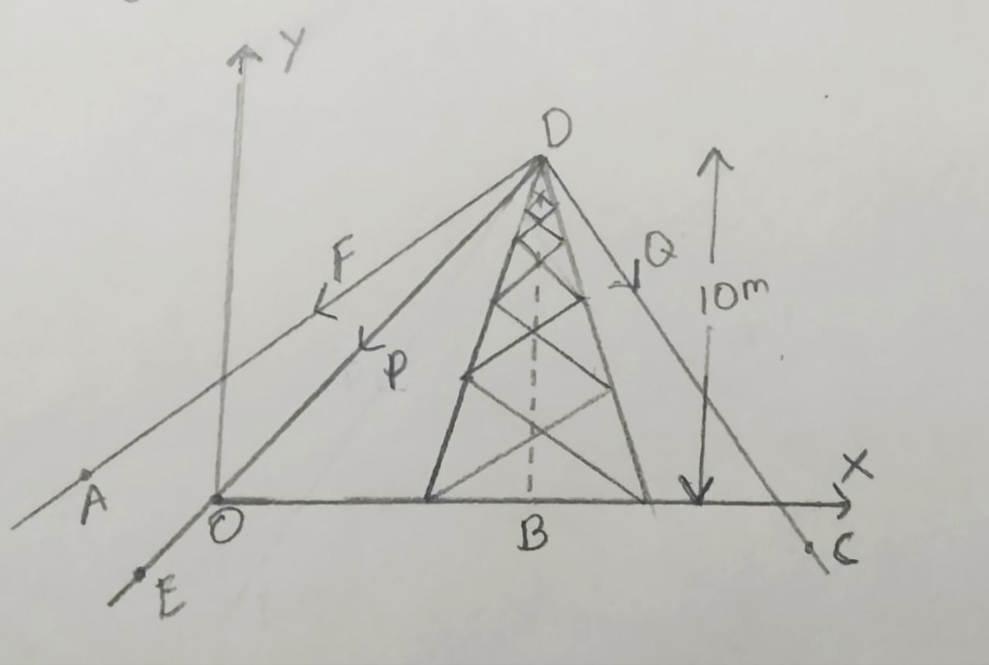
QUESTION 2
A) Three forces F,P and Q is been applied to the top of a toy tower (height 10m) as shown in the figure. The force F is applied through a rope attached to the top of the tower randomly from all directions to break the tower BD. Magnitude of the forces F and P is found to be 90N and 150N respectively. The magnitude of force Q is adjusted accordingly so that the resultant force acting will be parallel to the height of the tower.
B) Using Matlab, write a code that takes inputs of forces P, F and the coordinates of the rope position and check whether the tower breaks or not. Experiments shown that the tower collapses when the force (both tensile and compressive) acting on the toy tower exceeds greater than 444N.

Slide 9
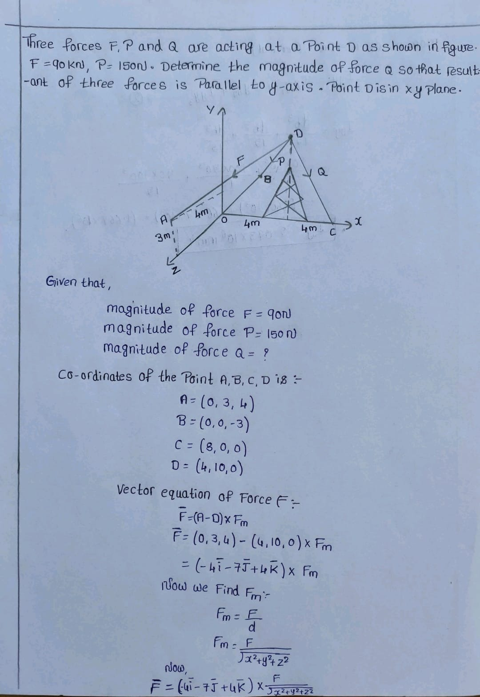
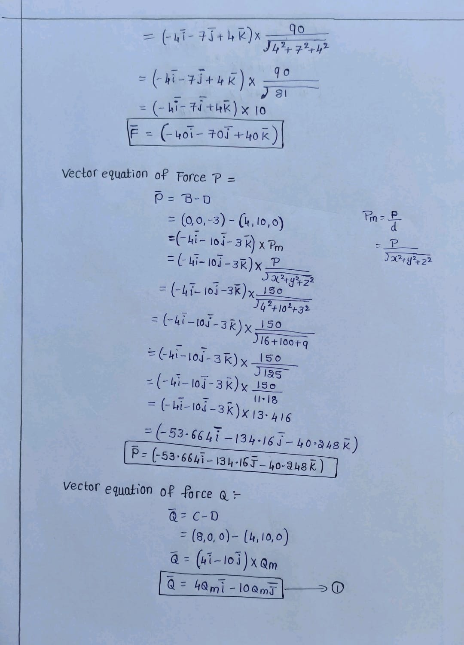

Slide 10
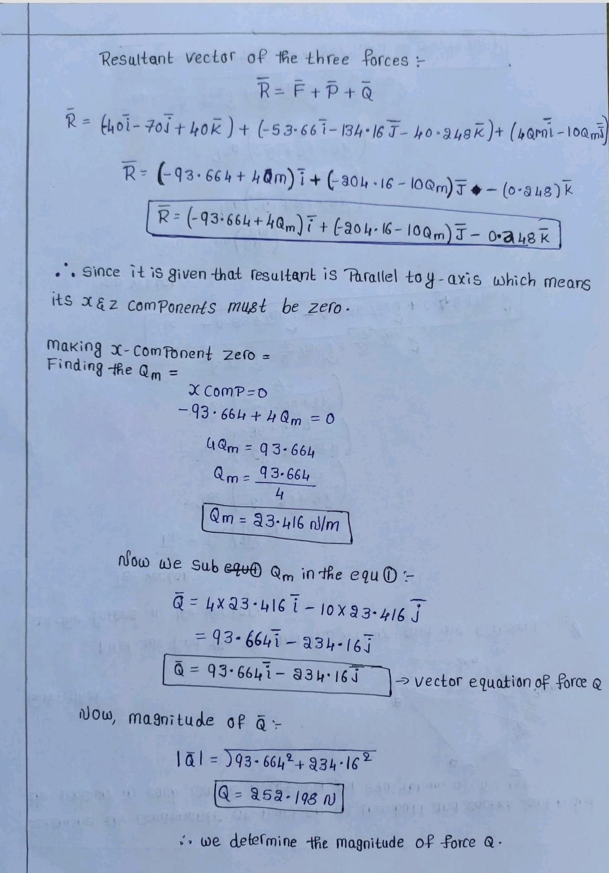

Slide 11
Concepts
VECTORS REPRESENTATION
RESULTANT OF VECTOR
MAGNITUDE OF THE FORCE

Slide 12
F = input('Force: ');
P = input('Force P: ');
l = input('Enter x coordinate of the rope AD: ');
m = input('Enter y coordinate of the rope AD: ');
n = input('Enter z coordinate of the rope AD: ');
AD = [l-4 m-10 n];
OD = [-4 -10 0];
CD = [4 -10 0];
BD = [0 -10 0];
ADp = AD/norm(AD);
ODp = OD/norm(OD);
CDp = CD/norm(CD);
BDp = BD/norm(BD);
Q = -(F*ADp(1) + P*ODp(1))/CDp(1);
R = (F*ADp(2) + P*ODp(2) + Q*CDp(2))/BDp(2);
disp('Force acting on the tower: ');
disp(R);
if(R>444||R<-444),
disp('Tower collapsed');
else
disp('Tower not collapsed');
endif
MATLAB CODE

Slide 13
OUTPUT
Force: 90
Force P: 150
Enter x coordinate of the rope AD: 0
Enter y coordinate of the rope AD: 3
Enter z coordinate of the rope AD: 4
Force acting on the tower:
448.54
Tower collapsed

Slide 14
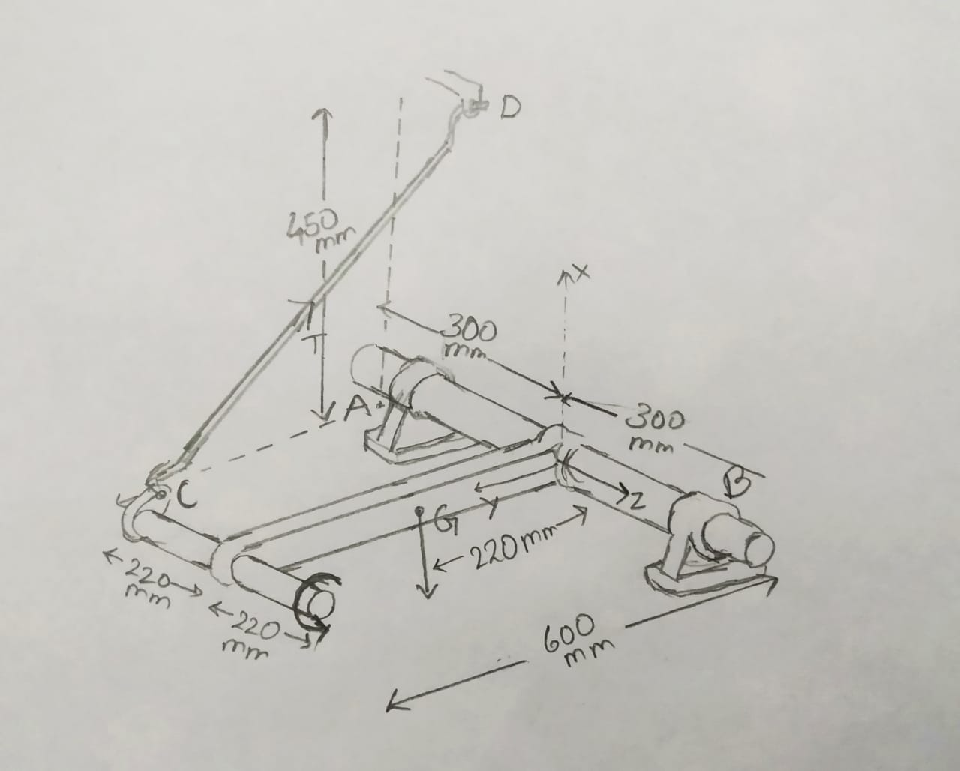
QUESTION 3
(A) The shaft, lever, and handle are welded together and constitute a single rigid body. Their combined mass is 28kg with mass centre at G. The assembly is mounted in bearings A and B, and the rotation is pre-vented by link CD. Determine the forces exerted on the shaft by bearings A and B while the 30Nm couple is applied to the handle as shown.
B) To make the mechanical process productive and faster the varying couple is applied at C (Couple increases at the rate of 1.2Nm/s). It was found that if the force applied at the bearings is greater than 1000, the bearings breaks and the entire system collapse. The pointer D of the string CD moves elliptically with centre at (450mm,600mm,200mm) in x-y plane at an angle of 1°/s. Using Matlab, determine the time, couple at C, coordinates of the pointer D at which the machine collapses such necessary precautions can be made while running the shaft.

Slide 15
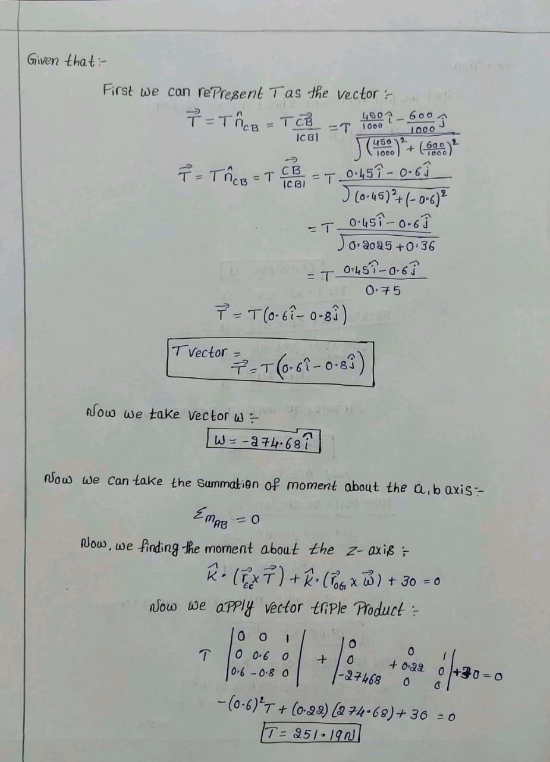
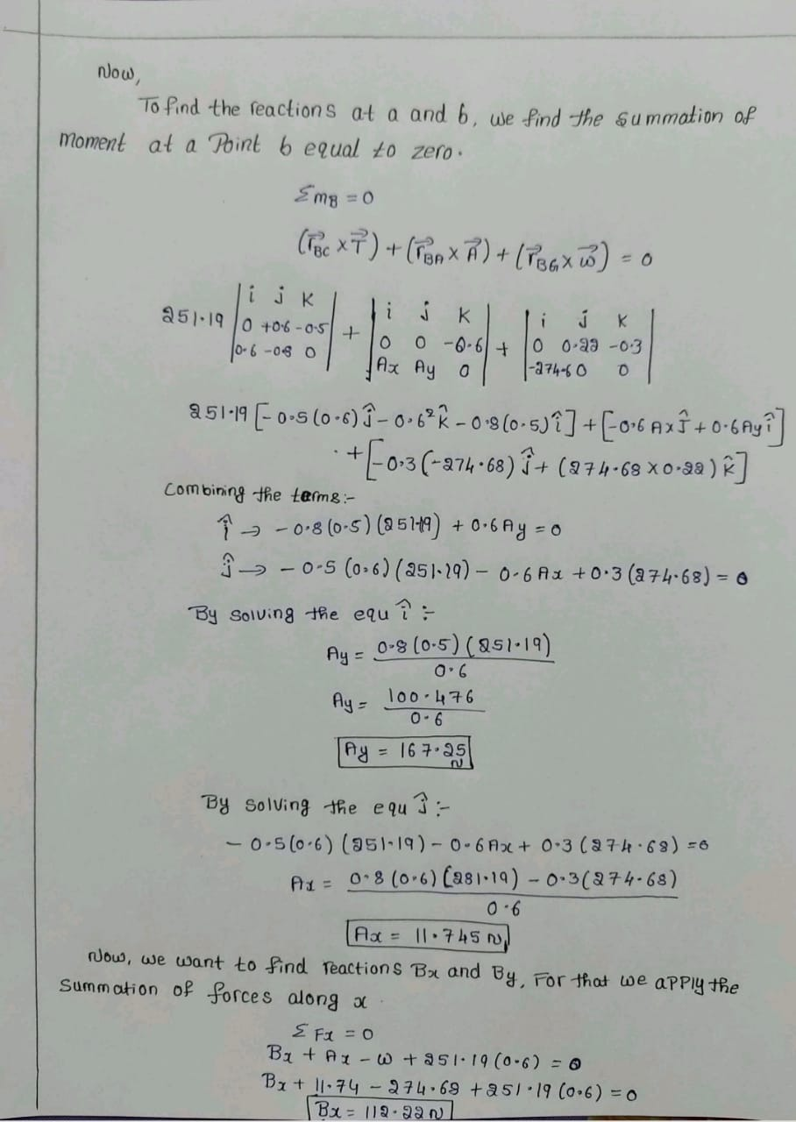

Slide 16
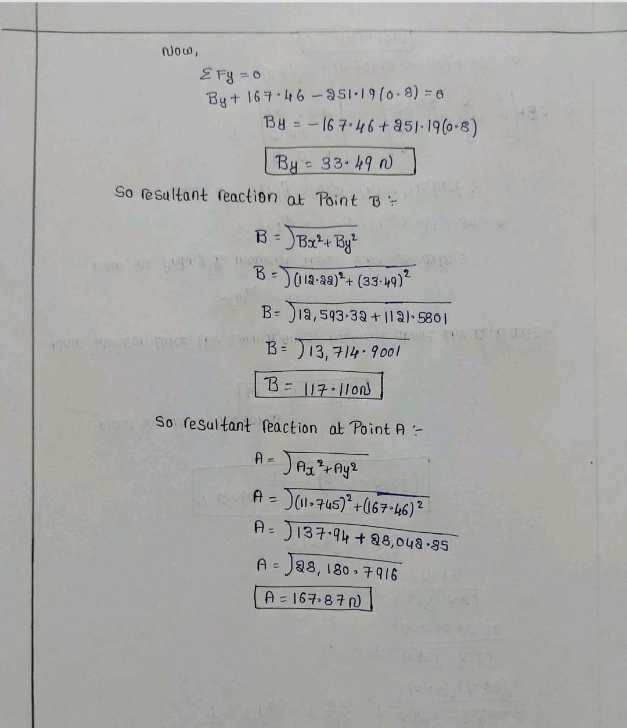

Slide 17
Concepts
COUPLE
VECTOR REPRESENTATION
MOMENT
EQUILIBRIUM
RESULTANT REACTION

Slide 18
t = 0:1:2000;
Force = input('Force at which the support pin breaks: '); //1000N
for( D = [0.45*sind(t)+0.45;0.6*cosd(t)+0.6;1.2*t;t] ),
time = D(4);
x = D(1);
y = D(2);
Couple = D(3);
W = [-274.68,0,0];
nCD = [x,-y,0];
n = nCD/norm(nCD);
rEC = [0 y 0];
rOG = [0 0.22 0];
rBC = [0 y -0.5];
rBG = [0 0.22 -0.3];
rBA = [0 0 -0.6];
k = [0 0 1];
EC_X_T = [k;rEC;n];
OG_X_W = [k;rOG;W];
T = - (det(OG_X_W)+Couple)/det(EC_X_T);
Zero = [0,0,0];
Tv = T.*n;
MATLAB CODE

Slide 19
rBC_X_T = cross(rBC,Tv);
rBG_X_W = cross(rBG,W);
rBA_X_A = Zero - rBC_X_T - rBG_X_W ;
Ax = (rBA_X_A(2)/(-0.6));
Ay = (rBA_X_A(1)/0.6);
A = [Ax Ay];
Anorm = norm(A);
Anorm = abs(Anorm);
Bx = -Ax - W(1) - Tv(1);
By = -Ay - Tv(2) - W(2) ;
B = [Bx By];
Bnorm = norm(B);
if(Anorm>=1000||Bnorm >= 1000),
break;
endif
end
disp('The mechanical structure breaks at : ');
disp('Time(in seconds) = '),disp(time);
disp('Couple = '),disp(Couple);
disp('Needle D at: '),disp([D(1),D(2)]);
MATLAB CODE

Slide 20

OUTPUT
The mechanical structure breaks at :
Time(in seconds) =
137
Couple =
164.40
Needle D at:
0.7569 0.1612

Slide 21
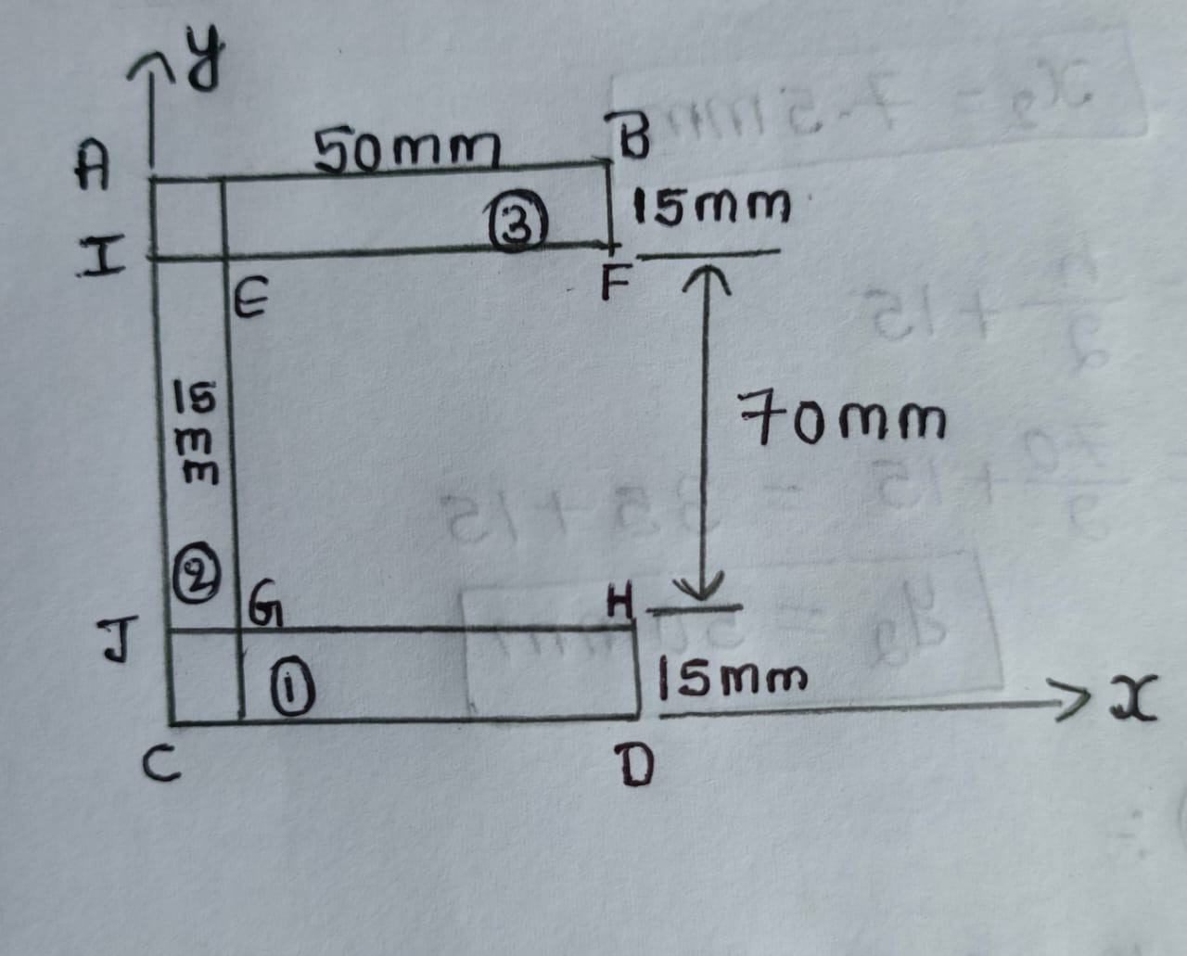
QUESTION 4
A)Find the centre of gravity of the following framework with respect to point C.
B)Using Matlab, find the centre of gravity of the section whose dimensions are taken as input from the user. Also user inputs the point of reference to which the centroid is calculated.

Slide 22
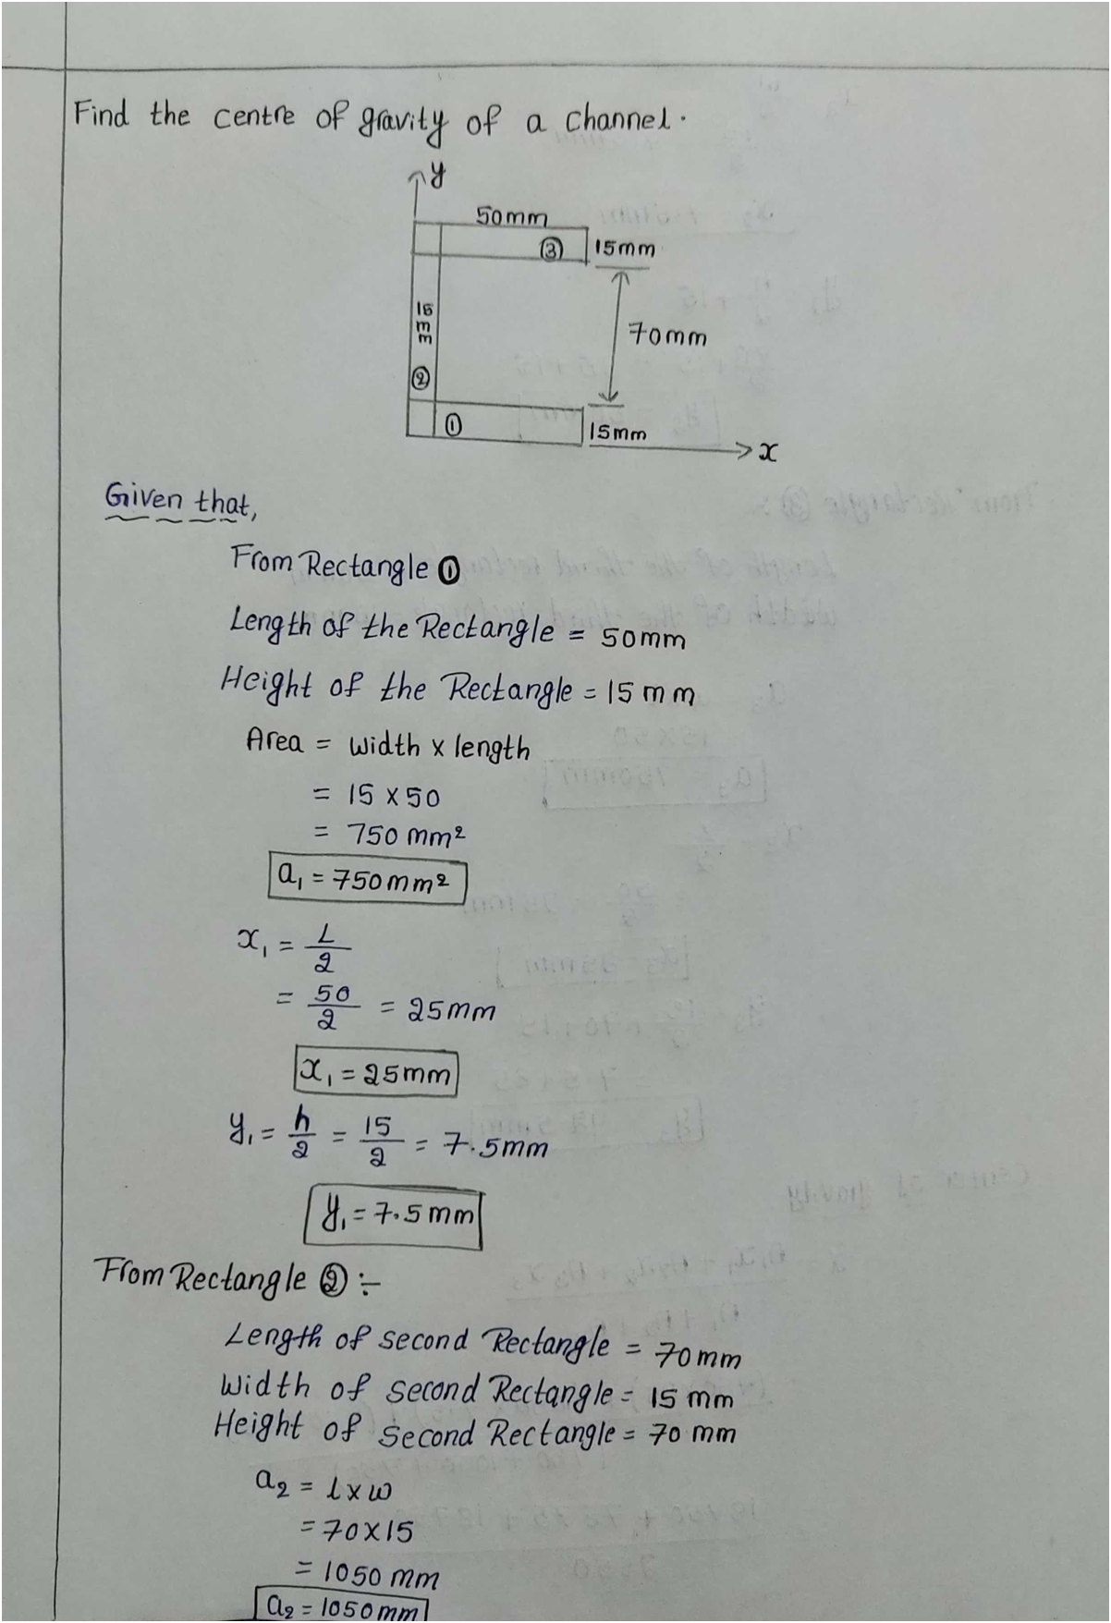
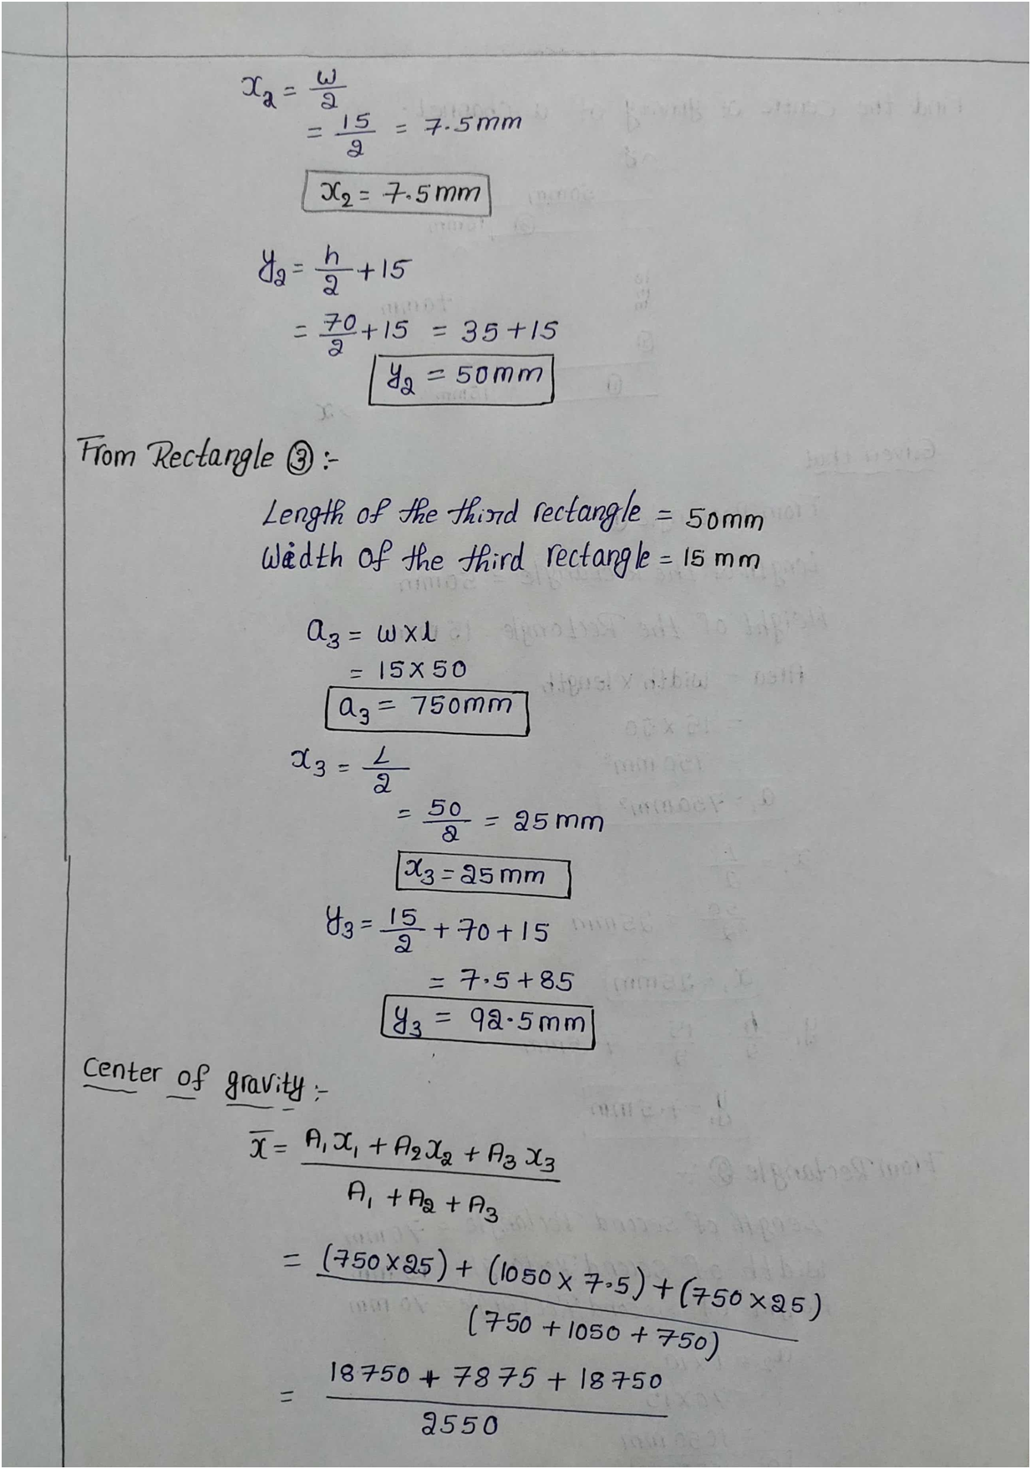

Slide 23
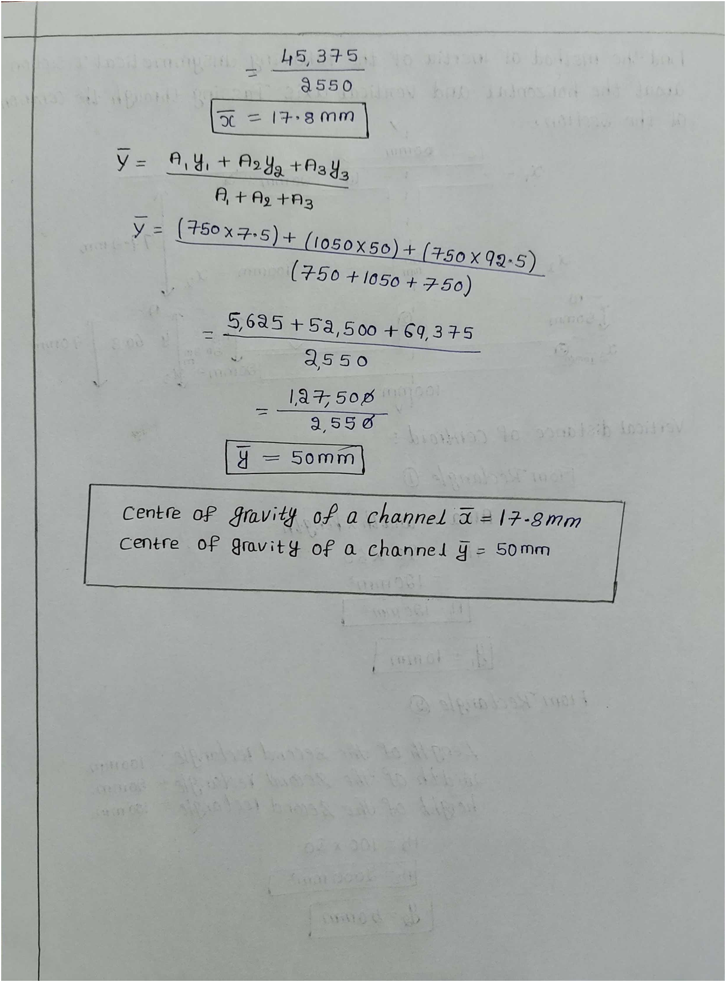

Slide 24
Concepts
CENTER OF GRAVITY

Slide 25
%User inputs
choice = input('Reference Origin: ',"s");
l1 = input('l1 = ');
b1 = input('b1 = ');
l2 = input('l2 = ');
b2 = input('b2 = ');
l3 = input('l3 = ');
b3 = input('b3 = ');
A1 = l1*b1;
A2 = l2*b2;
A3 = l3*b3;
A = A1+A2+A3;
%C
if(choice == 'C'||choice == 'c'),
x1 = b1/2;
x2 = l2/2;
x3 = l3/2;
y1 = (l1/2)+b3;
y2 = (b2/2)+l1+b3;
y3 = b3/2;
% A
elseif(choice=='A'||choice=='a'),
x1 = b1/2;
x2 = l2/2;
x3 = l3/2;
y1 = -((l1/2)+b2);
y2 = -(b2/2);
y3 = -((b3/2)+l1+b2);
MATLAB CODE

Slide 26
%B
elseif(choice=='B'||choice=='b'),
x1 = -(l2-(b1/2));
x2 = -(l2/2);
x3 = -(l2-(l3/2));
y1 = -(b2 + (l1/2));
y2 = -(b2/2);
y3 = -(b2 + l1 +(b3/2));
%D
elseif(choice=='D'||choice=='d'),
x1 = -(l3 - (b1/2));
x2 = -(l3-(l2/2));
x3 = -(l3/2);
y1 = b3 + (l1/2);
y2 = b3+l1+(b2/2);
y3 = b3/2;
%F
elseif(choice=='F'||choice=='f'),
x1 = -(l2-(b1/2));
x2 = -(l2/2);
x3 = -(l2 - (l3/2));
y1 = -(l1/2);
y2 = b2/2;
y3 = -(l1 + (b3/2));
%H
elseif(choice=='H'||choice=='h'),
x1 = -(l3 - (b1/2));
x2 = -(l3 - (l2/2));
x3 = -(l3/2);
y1 = l1/2;
y2 = l1 + (b2/2);
y3 = -(b3/2);
MATLAB CODE

Slide 27
%E
elseif(choice=='E'||choice=='e'),
x1 = -(b1/2);
x2 = (l2/2)-b1;
x3 = (l3/2)-b1;
y1 = -(l1/2);
y2 = b2/2;
y3 = -(l1+(b3/2));
%G
elseif(choice=='G'||choice=='g'),
x1 = -(b1/2);
x2 = (l2/2)-b1;
x3 = (l3/2)-b1;
y1 = l1/2;
y2 = l1+(b2/2);
y3 = -(b3/2);
%I
elseif(choice=='I'||choice=='i'),
x1 = b1/2;
x2 = l2/2;
x3 = l3/2;
y1 = -(l1/2);
y2 = b2/2;
y3 = -(l1 + (b3/2));
%J
elseif(choice=='J'||choice=='j'),
x1 = b1/2;
x2 = l2/2;
x3 = l3/2;
y1 = l1/2;
y2 = l1+(b2/2);
y3 = -(b3/2)
else,
disp('Invalid Input');
end
%Output
x = (A1*x1+A2*x2+A3*x3)/A;
y = (A1*y1+A2*y2+A3*y3)/A;
Centroid = [x,y];
disp('Centroid w.r.t Reference point is: '),disp(Centroid);
MATLAB CODE

Slide 28
OUTPUT
Reference Origin: C
l1 = 70
b1 = 14
l2 = 100
b2 = 15
l3 = 100
b3 = 18
Centroid w.r.t Reference point is:
40.154 49.390

Slide 29
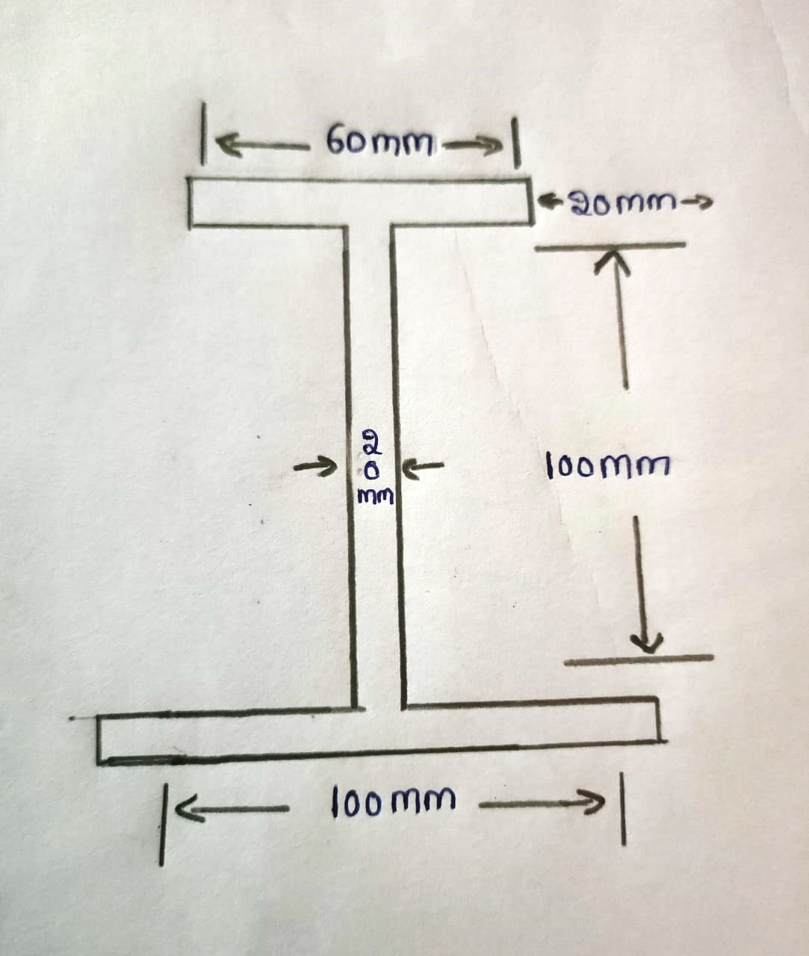
QUESTION 5
A) Find the Moment of Inertia of the following Unsymmetrical I- section about the Horizontal, vertical Axis Passing Through the Centroid of the Section.
B) Using Matlab, develop a code that takes user inputs for the lengths of the three strips forming I section and find Moment of Inertia about the Horizontal, vertical Axis and perpendicular axis passing through the Centroid of the Section.

Slide 30
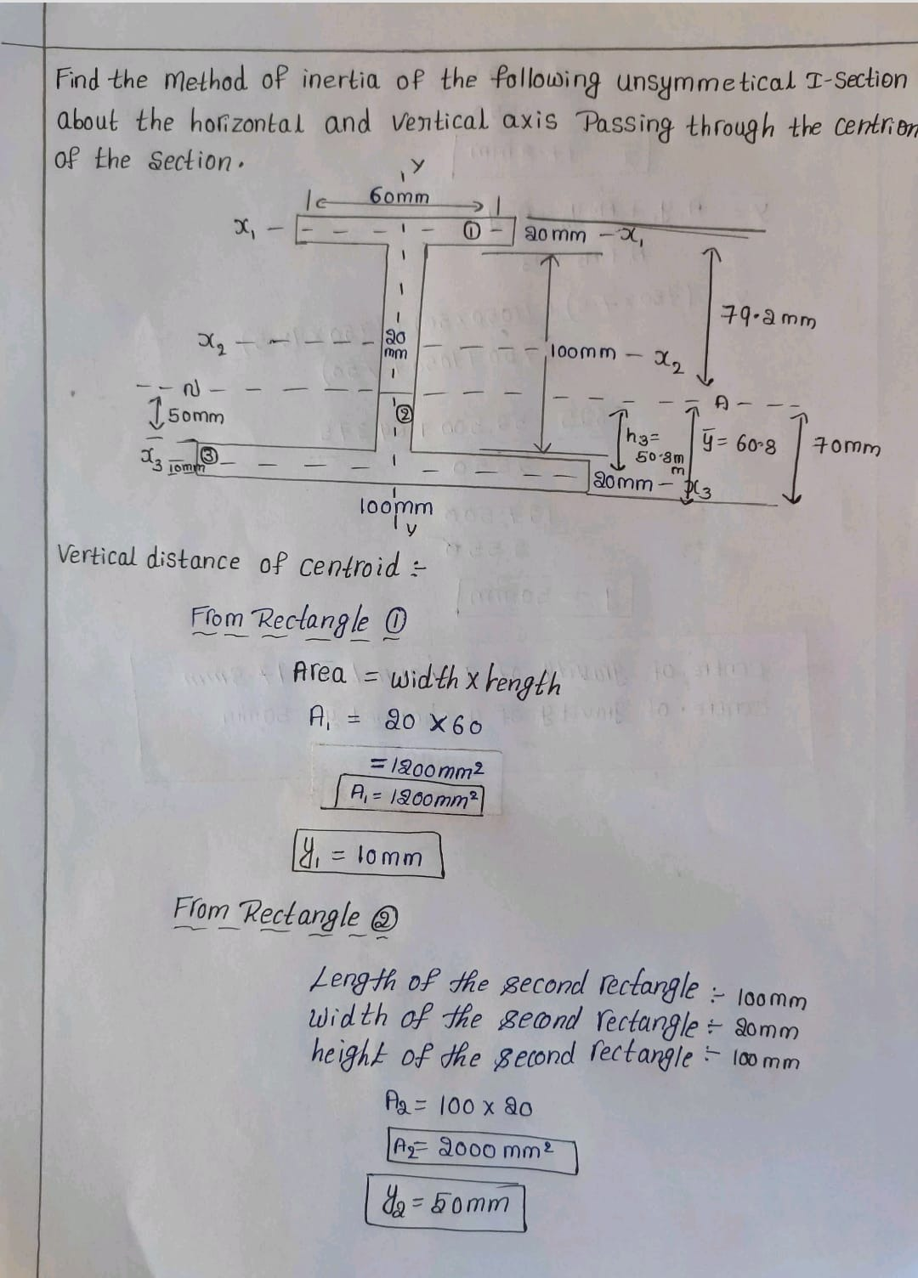
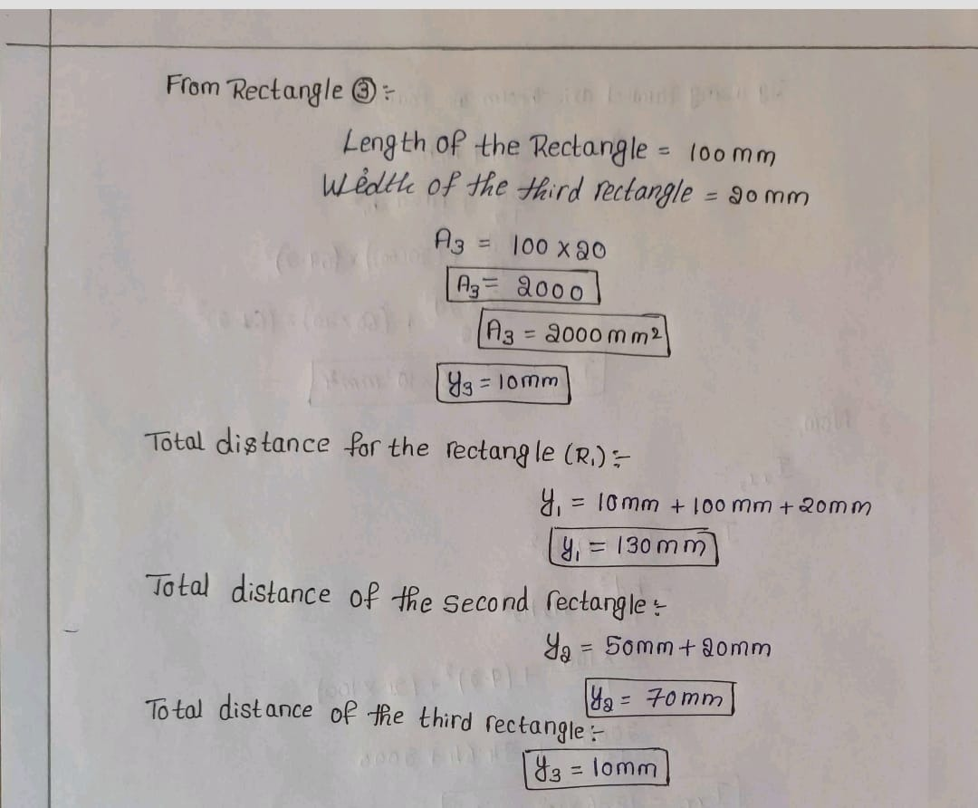
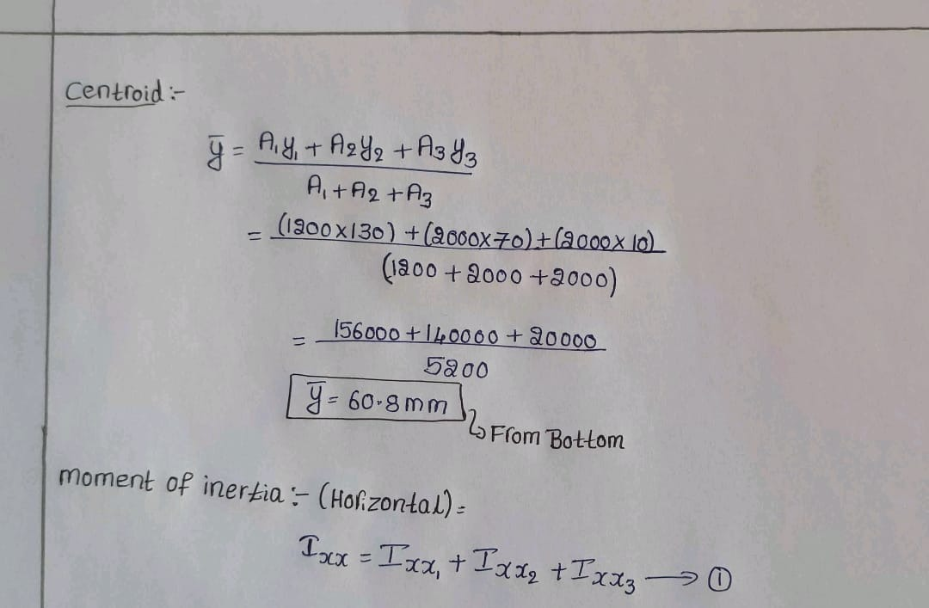

Slide 31
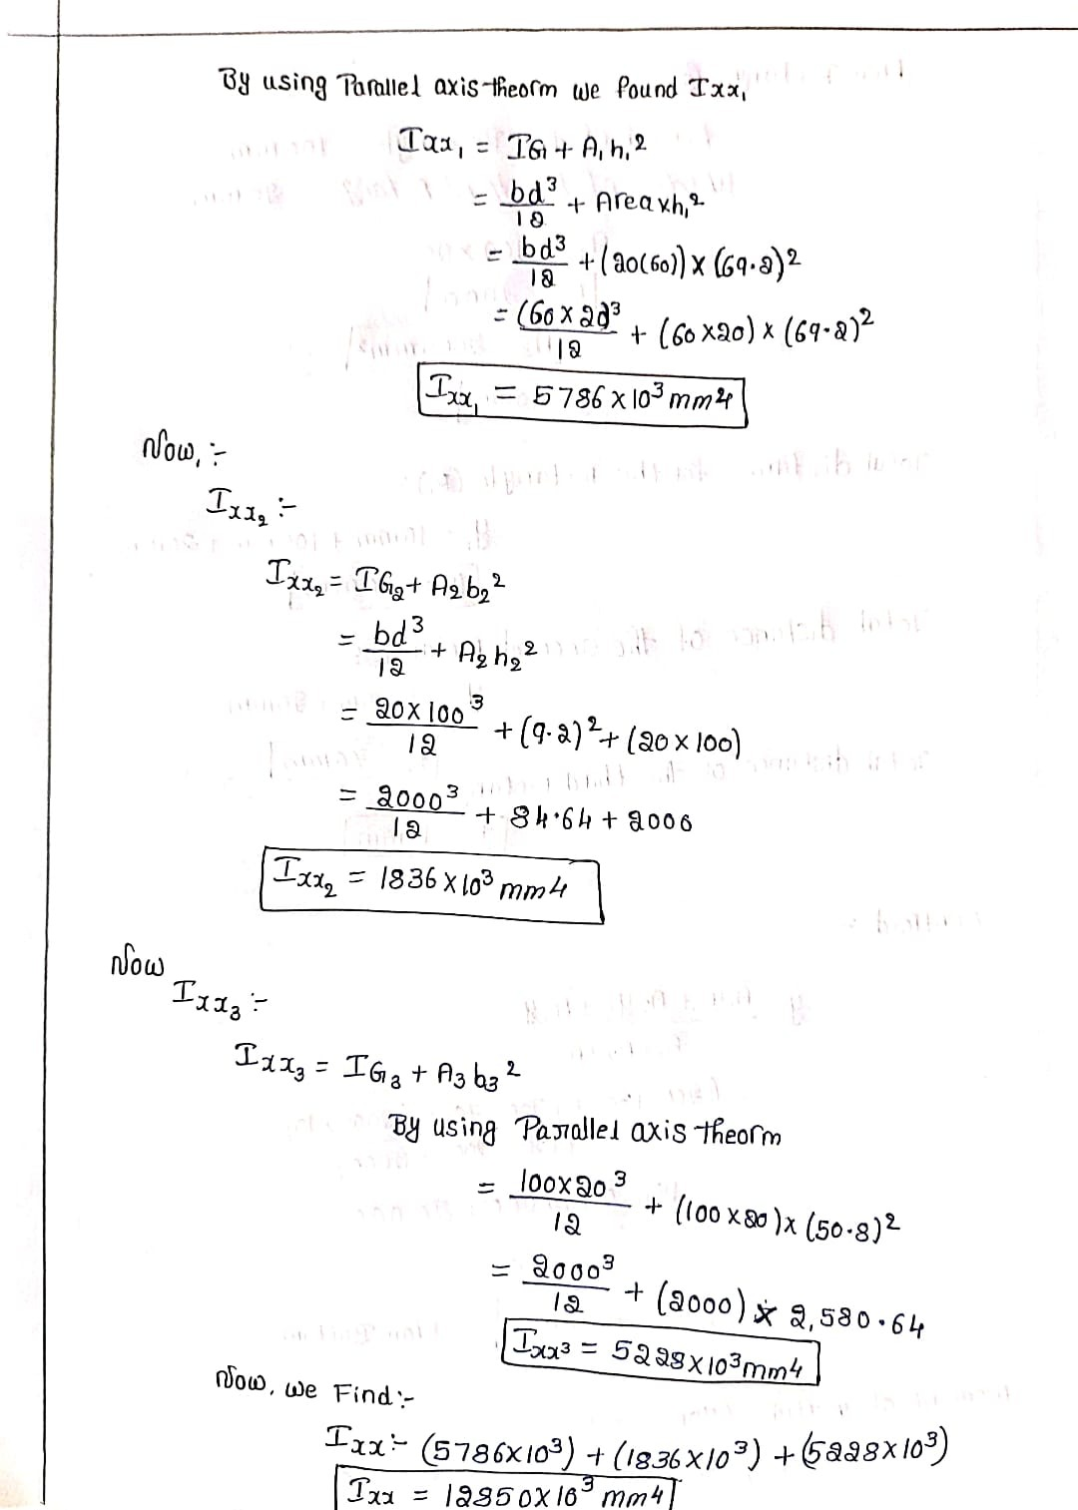
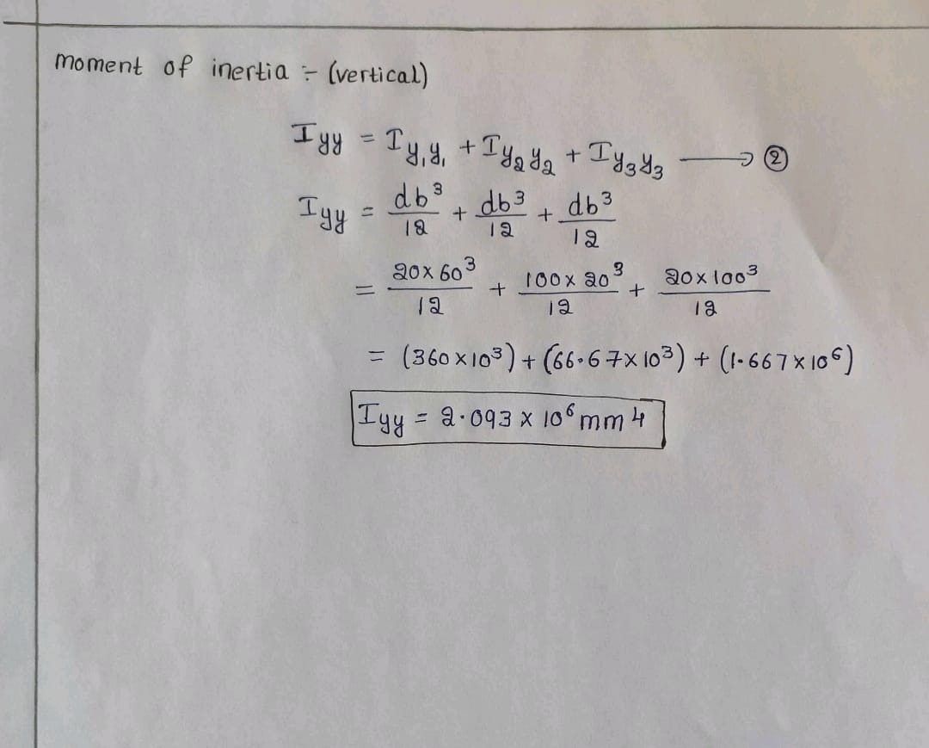

Slide 32
Concepts
Moment of Inertia
CENTROID OF SECTION
PARALLEL AXIS THEORM
PERPENDICULAR AXIS THEOREM

Slide 33
l1 = input('l1 = ');
l2 = input('l2 = ');
l3 = input('l3 = ');
A1 = 20*l1;
A2 = 20*l2;
A3 = 20*l3;
y1 = 20+l2+1;
y2 = 20+(l2/2);
y3 = 20/2;
A = A1+A2+A3;
yc = (A1*y1+A2*y2+A3*y3)/A;
I1x = (1/12)*A1*(20^2);
I2x = (1/12)*A2*(l2^2);
I3x = (1/12)*A3*(20^2);
I1y = (1/12)*A1*(l1^2);
I2y = (1/12)*A2*(20^2);
I3y = (1/12)*A3*(l3^2);
d1 = abs(yc-y1);
d2 = abs(yc-y2);
d3 = abs(yc-y3);
MATLAB CODE

Slide 34
%Parallel axis theorem
I1cx = I1x+A1*(d1^2);
I2cx = I2x+A2*(d2^2);
I3cx = I3x+A3*(d3^2);
Ix = I1cx+I2cx+I3cx;
Iy = I1y+I2y+I3y;
% Perp axis theorem
Iz = Ix+Iy;
disp('Moment of inertia through horizontal axis passing through centroid, Ix: ')
disp(Ix)
disp('Moment of inertia through vertical axis passing through centroid, Iy: ')
disp(Iy)
disp('Moment of Inertia perpendicular to plane passing through centroid, Iz: ')
disp(Iz)
MATLAB CODE

Slide 35
OUT PUT
l1 = 120
l2 = 70
l3 = 100
Moment of inertia through horizontal axis passing through centroid, Ix:
7.8765e+06
Moment of inertia through vertical axis passing through centroid, Iy:
4.5933e+06
Moment of Inertia perpendicular to plane passing through centroid, Iz:
1.2470e+07

Slide 36
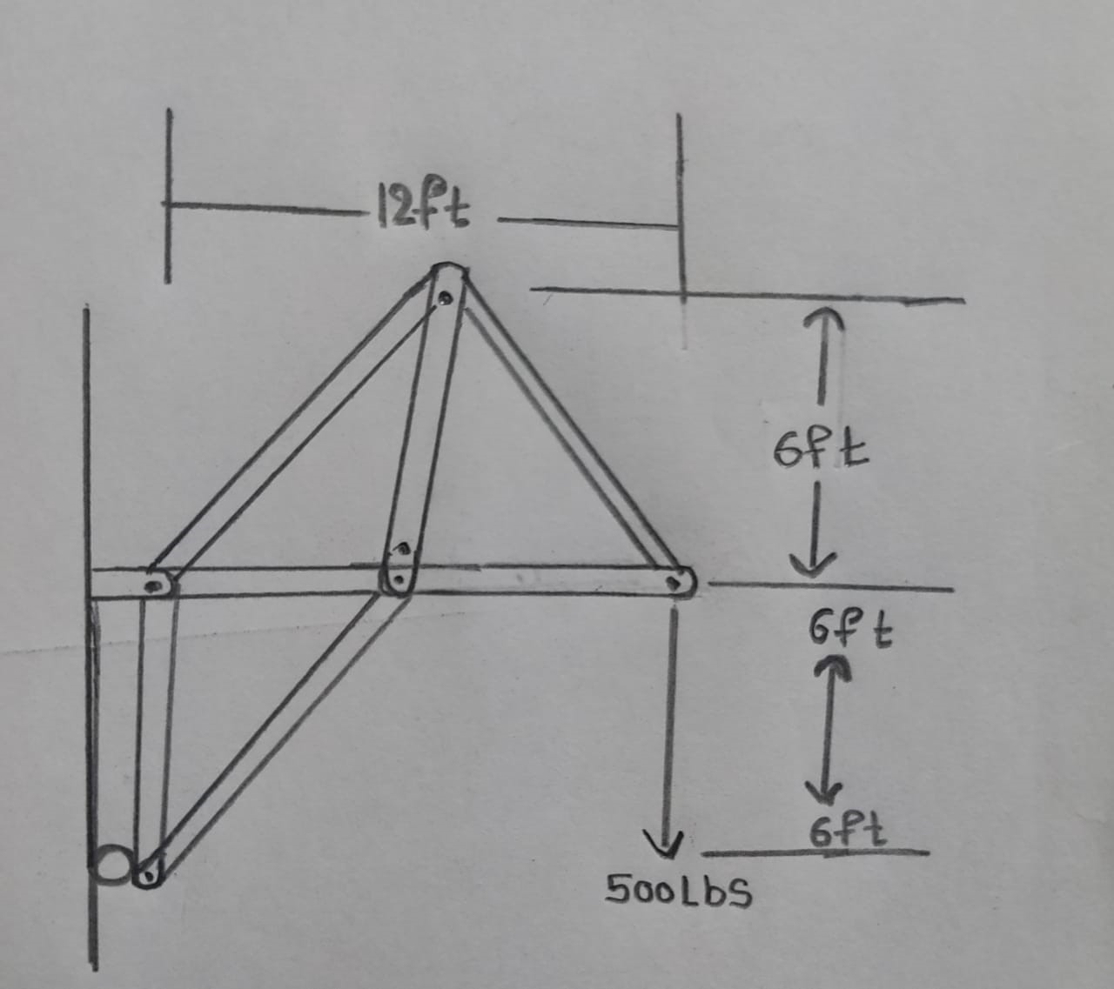
QUESTION 6
(A) Using the method of sections find the forces in members AB, AC and AD of mechanical structure that carries a sand load
It is found that the member AD will collapse when the tension or compressive force exceeds 2369.6 lbs. It is also noted that the workers fill the sand carrier in such a way that the weight of the sand increases 2 lbs/seconds. What is the maximum load the workers can fill such that the mechanical truss does not collapse? (Use Matlab)

Slide 37
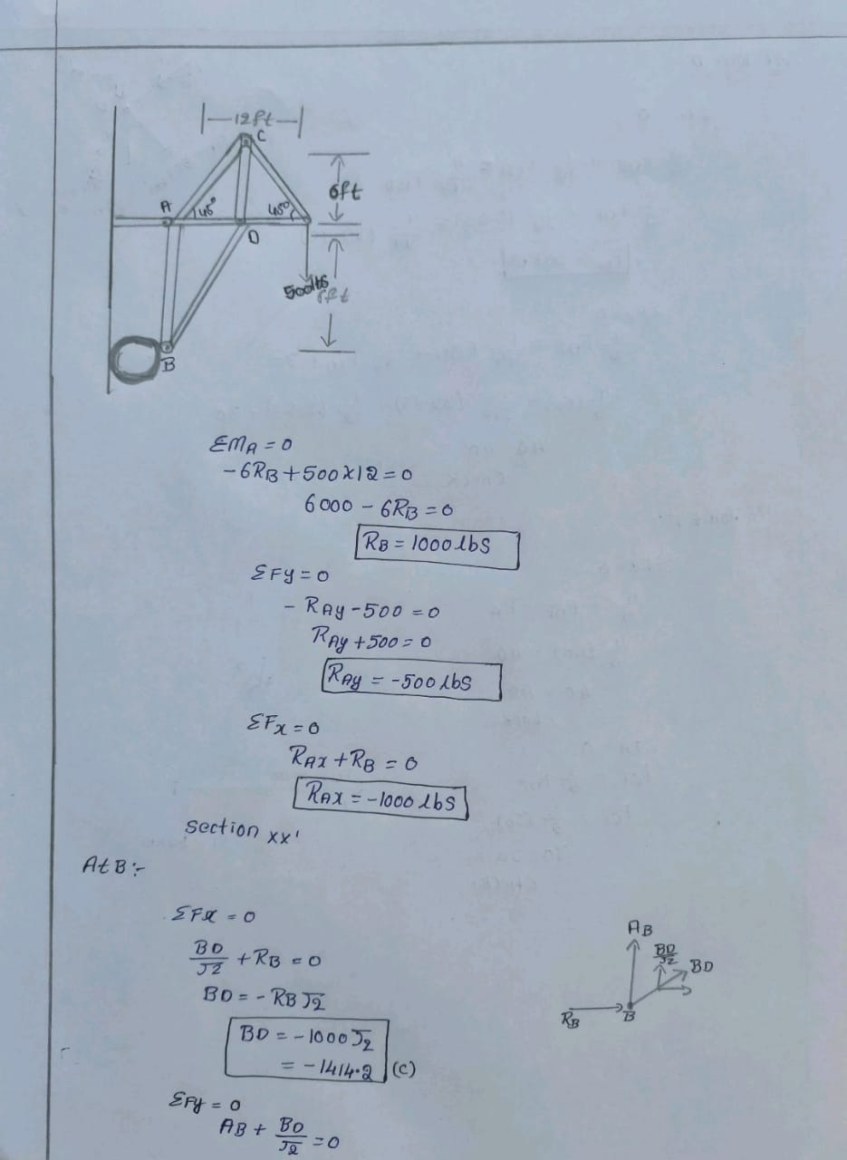
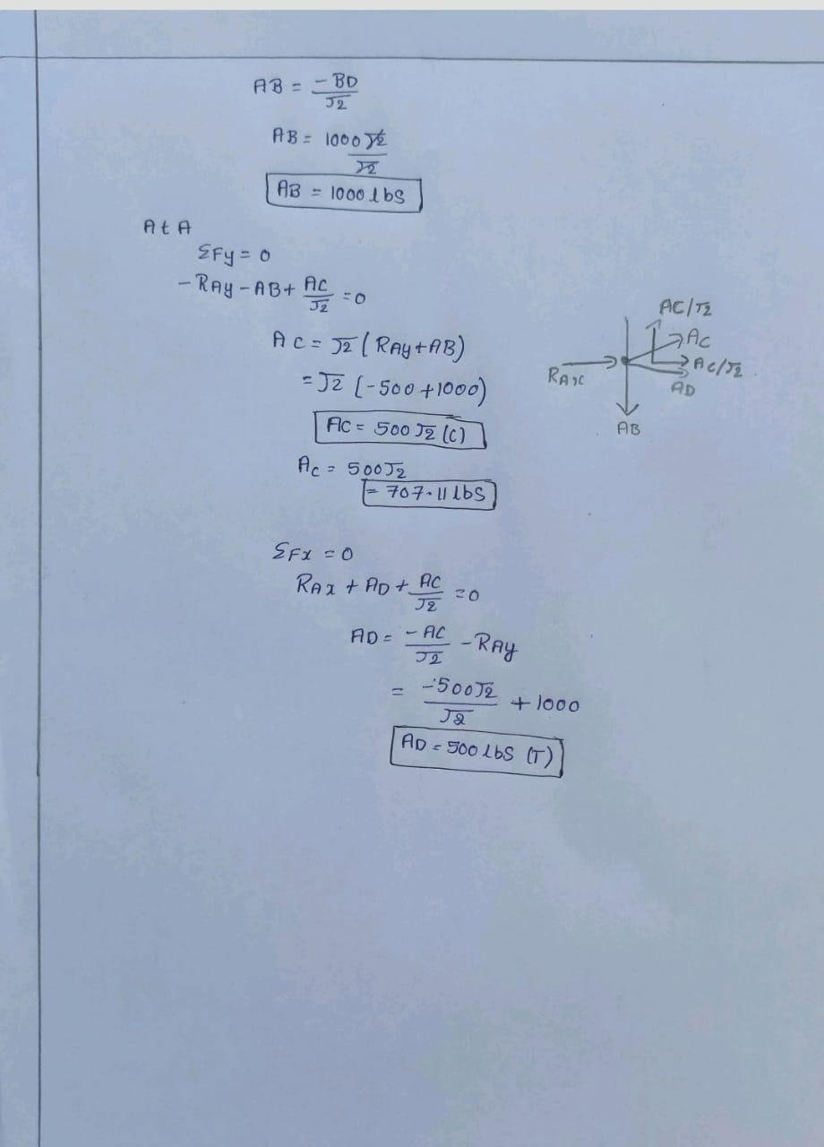

Slide 38
Members | Force | Nature
AB | 1000 | T
AC | 707.11 | T
AD | 500 | T

Slide 39
Concepts
METHOD OF SECTIONS
EQUILIBRIUM CONDITIONS
SUPPORT REACTIONS

Slide 40
for (t = 0:1:1500),
x = 2*t ;
RB=2*x;
RAY = -x;
RAX = -RB;
BD = -RB*sqrt(2);
AB = -BD/sqrt(2);
AC = (RAY + AB)*sqrt(2);
AD = -(RAX + AC/sqrt(2));
AD_abs = abs(AD);
if (AD_abs >= 2369.6),
x
break;
endif
end
disp('The maximum load is: ');
disp(x);
MATLAB CODE

Slide 41
OUTPUT
x = 2370
The maximum load is:
2370

Slide 42
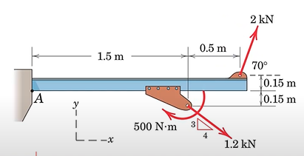
QUESTION 7
The flanged steel cantilever beam with riveted bracket is subjected to a couple and two forces as shown and their design of the attachment at A must be determined. Replace the two forces and couple by an equivalent couple M and resultant force R at A.
Using Matlab code-
A) Develop a system that takes user inputs of force F1, F2 and the and their angle of action with the horizontal α and β and also the moment that acts at C and solve it to find the equivalent couple M and resultant force R at A.
B) If F1 = 2kN , F2 = 1.2kN, Mc = 0.5kNm. Then plot a graph showing the variations of the equivalent moment at A, magnitude of the resultant force, angle at which the resultant force acts if angle at the F1 and F2 acts is varies as follows
C)Angle α varies from 0° to 360° at steps of 1° and angle β varies with α at a positive phase difference of 90°

Slide 43
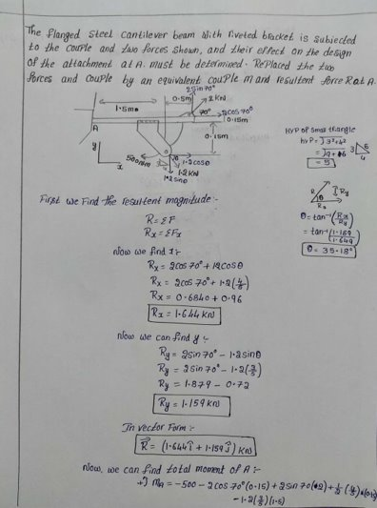
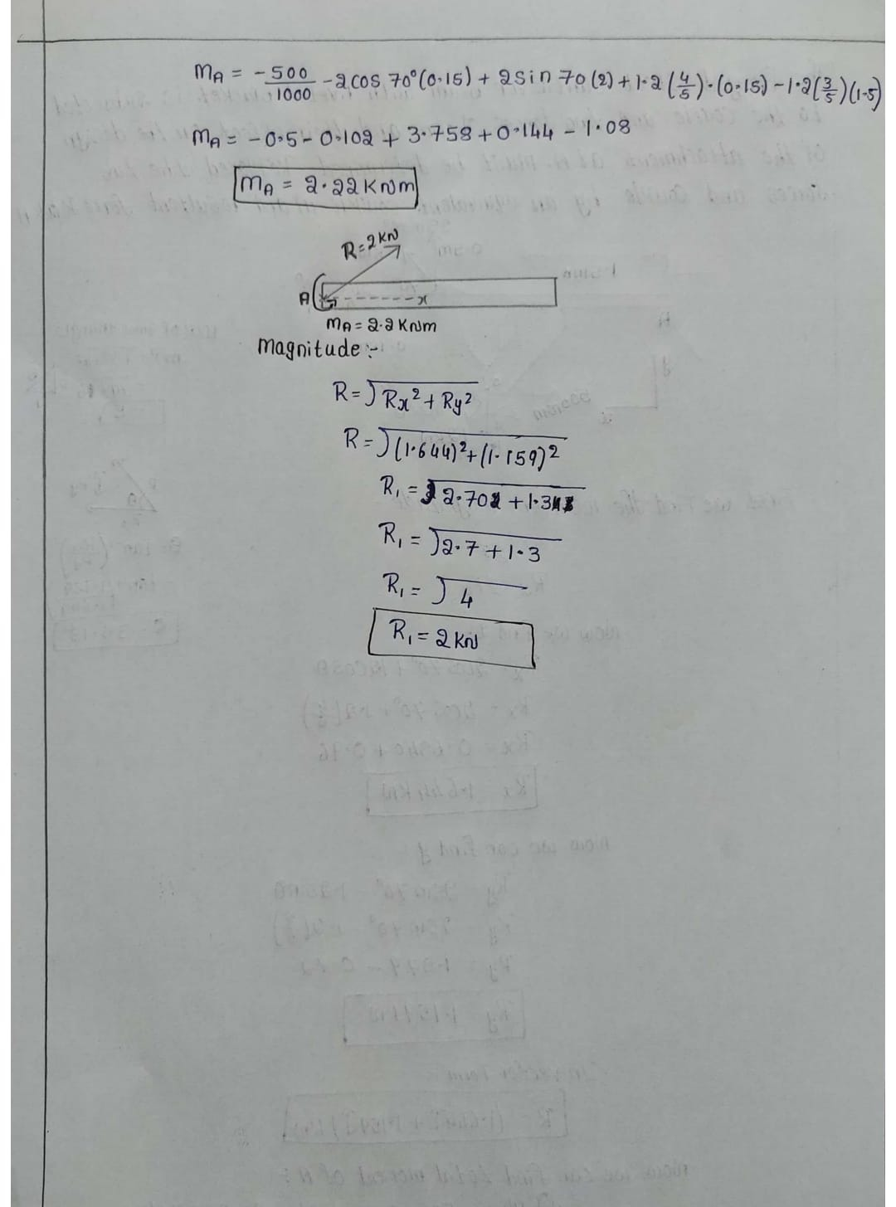

Slide 44
Concepts
COUPLE
RESULTANT MAGNITUDE
VECTOR RESOLUTION
MOMENT

Slide 45
F1 = input('F1 : ');
F2 = input('F2 : ');
a = input('angle alpha: ');
b = input('angle beta: ');
M = input('Couple at C (Clockwise moment positive): ');
Rx = F1*cosd(a)+F2*cosd(b);
Ry = F1*sind(a)+F2*sind(b);
R = [Rx Ry];
Rmag = norm(R);
ang = atand(Ry./Rx);
Ma = (-M)-(F1*cosd(a)*0.15)+(F1*sind(a)*2)+(F2*sind(b)*1.5)+(F2*cosd(b)*0.15);
disp('Couple M at A is: '),disp(Ma);
disp('Resultant force: '),disp(R);
disp('Angle of direction of the resultant force: '),disp(ang);
MATLAB CODE

Slide 46
OUTPUT
F1 : 2
F2 : 1.2
angle alpha: 70
angle beta: -atand(3/4)
Couple at C (Clockwise moment positive): 0.5
Couple M at A is:
2.2202
Resultant force:
1.6440 1.1594
Angle of direction of the resultant force:
35.192

Slide 47
theta = 0:1:360;
F1 = 2;
F2 = 1.2;
a = theta;
b = theta+90;
Rx = F1*cosd(a)+F2*cosd(b);
Ry = F1*sind(a)+F2*sind(b);
Rmag = (Rx.^2+Ry.^2).^(1/2);
ang = atand(Ry./Rx);
Ma = (-0.5)-(F1*cosd(a)*0.15)+(F1*sind(a)*2)+(F2*sind(b)*1.5)+(F2*cosd(b)*0.15);
subplot(1,3,1);
plot(theta,Ma,'r');
xlabel('Angle(degree)');
ylabel('Equivalent couple at A');
subplot(1,3,2);
plot(theta,Rmag,'g');
xlabel('Angle(degree)');
ylabel('ResultanT Force(kN)');
subplot(1,3,3);
plot(theta,ang,'b');
xlabel('Angle(degree)');
ylabel('Angle between resultant and horizontal');
MATLAB CODE

Slide 48
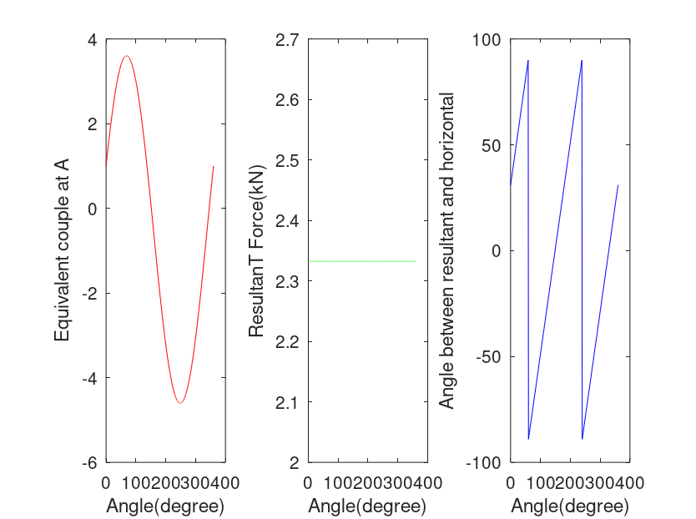
OUTPUT

Slide 49
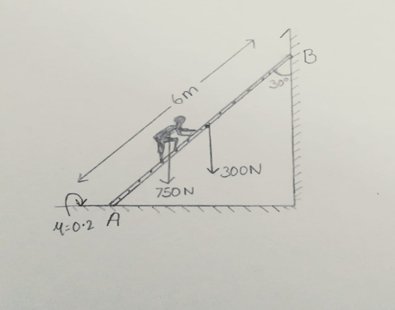
QUESTION 8
A) A Uniform ladder 6m weighing 300N is resting against a wall with which it makes 30 degrees. A man weighing 750N climbs up the ladder. At what position along the ladder from the bottom end does the ladder slips? The coefficient of friction for both the wall and floor with the ladder is 0.2.
B) The same ladder is taken to another place for use having different coefficient of friction and ladder is placed against the wall in some other angles. Using Matlab, make a system that finds whether the ladder is safe for climbing without any slip by taking user inputs for coefficient of frictions, the angle of ladder, and the weight of the person who climbs.

Slide 50
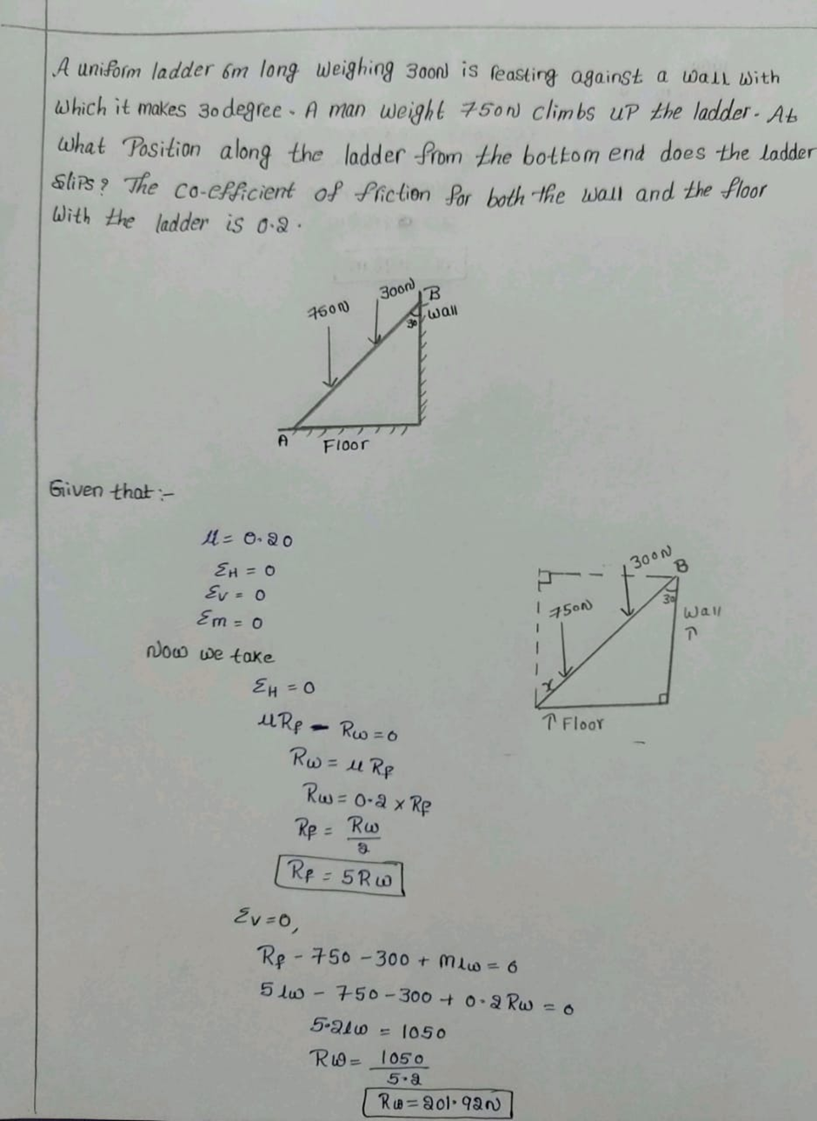
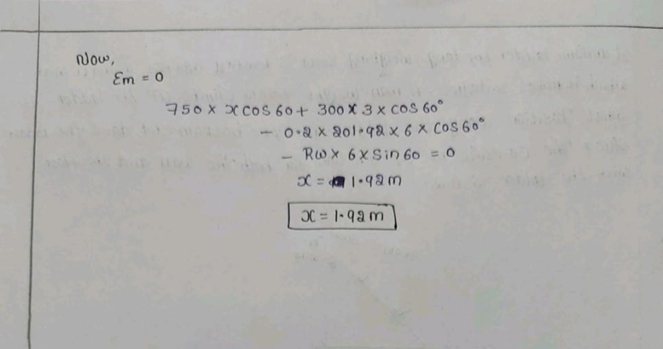

Slide 51
Concepts
Moment
Friction

Slide 52
uf = input('Coefficient of friction between floor and ladder: ');
uw = input('Coefficient of friction between ladder and wall: ');
W = input('Input your weight: ');
Wm = W*9.8;
Wlader = 300;
l = 6;
Angle = input('Angle between ladder and floor(in degrees(0 to 90)): ');
Rw = (Wm+Wlader)/(uf + (1/uw));
Fw = uw*Rw;
Rf = Rw/uf;
Ff = Rf*uf;
x = ((Fw*l*cosd(Angle))+(Rw*l*sind(Angle))-(Wlader*(l/2)*cosd(Angle)))/(Wm*cosd(Angle));
if(x<=l&&x>=0&&Angle<=90&&Angle>=0),
disp('Ladder slips when man is at '),disp(x),disp('metres from bottom of the ladder');
elseif(Angle>90||Angle<0),
disp('Invalid Input');
else,
disp('Ladder doesnot slips, Safer to climb');
endif
MATLAB CODE

Slide 53
OUTPUT
Coefficient of friction between floor and ladder: 0.2
Coefficient of friction between ladder and wall: 0.3
Input your weight: 75
Angle between ladder and floor(in degrees(0 to 90)): 56
Ladder slips when man is at
3.0380
metres from bottom of the ladder
258.60

Slide 54
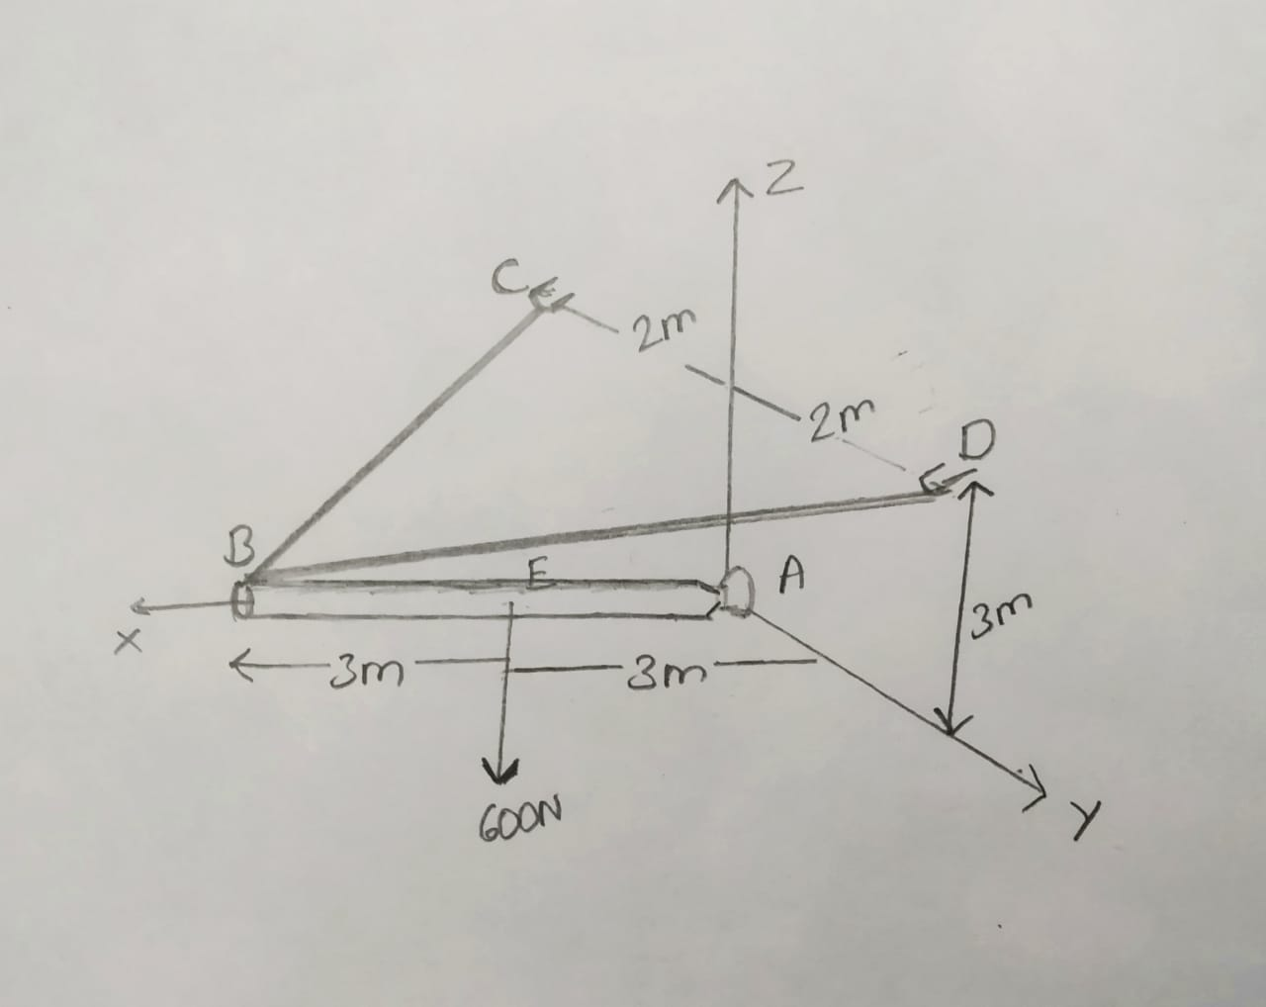
QUESTION 9
Determine the components of reaction at the ball and socket joint A and the tension in each cable necessary for equilibrium of the rod
Determine the tension on both the rope and check if it is exceeding its breakpoint by taking force acting on the rod, distance from the origin, and angle of force by taking input from user.

Slide 55
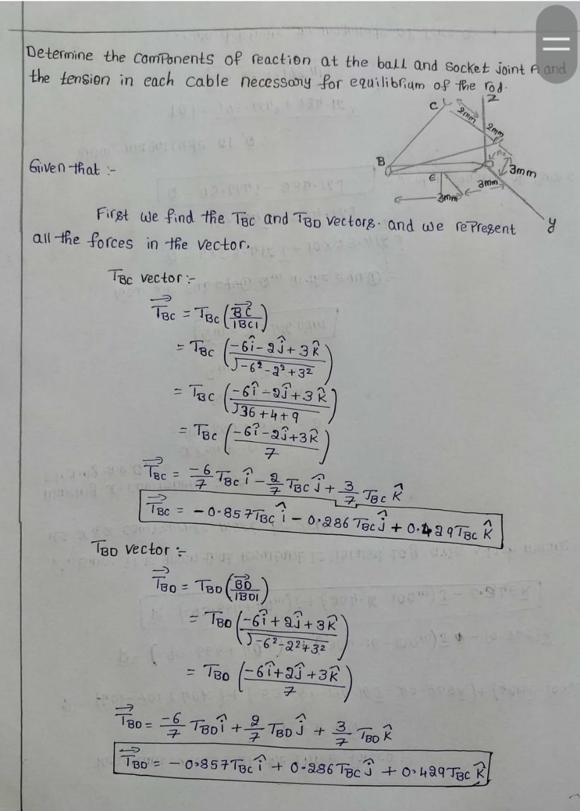
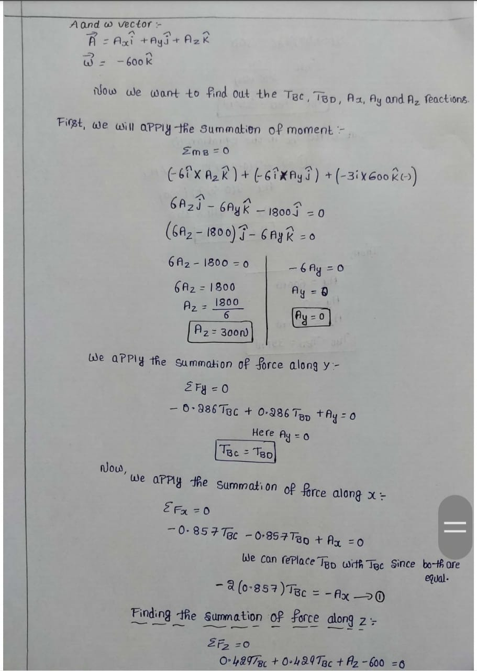

Slide 56
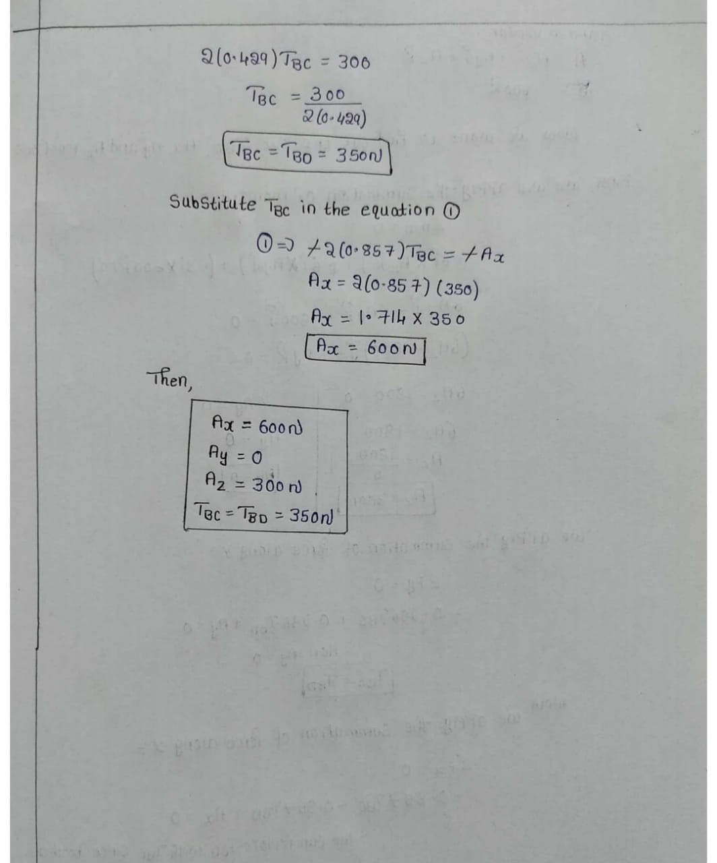

Slide 57
Concepts
VECTOR REPRESENTATION
EQUILIBRIUM CONDITIONS
MOMENT
FORCE

Slide 58
f=input("Enter Force on the pole: ");
d=input("Enter force distance from point A: ");
a=input("Enter angle (0-180) below x-axis: ");
m=((3^2)+(2^2)+(6^2))^(1/2);
Tz=(f*sind(a)*d)/12;
#T=Tz m/3
T=Tz*(m/3);
if (T>500)
disp("Tention on the cables is out of sustainable range: "),disp(T);
else
disp("Tention on both the rope: "),disp(T);
Endif
MATLAB CODE

Slide 59
OUTPUT
Enter Force on the pole: 250
Enter force distance from point A: 2
Enter angle (0-180) below x-axis: 90
Tention on both the rope:
97.222

